Slide 1
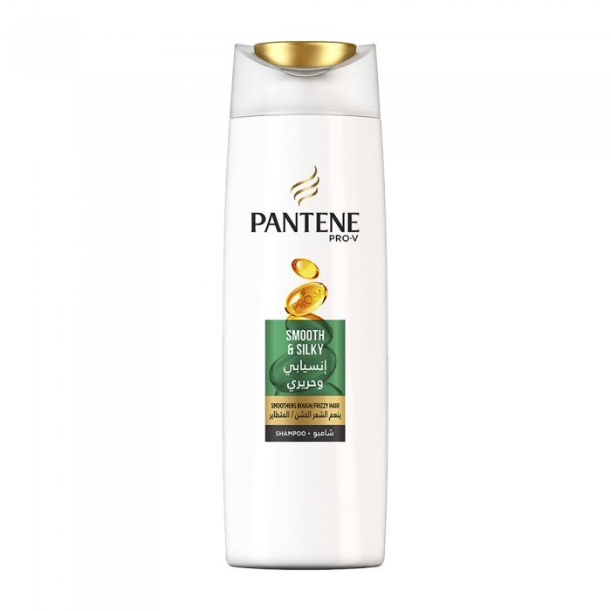
Streamlined and silky pantene shampoo 200 ml
13.80 SAR Q
- Pantene shampoo gently cleans curly hair and leaves it smooth as silk
- Makes hair more manageable and easier to untangle
- Makes hair stronger against damage to styling
- For curly, pale and rigid hair

Slide 2
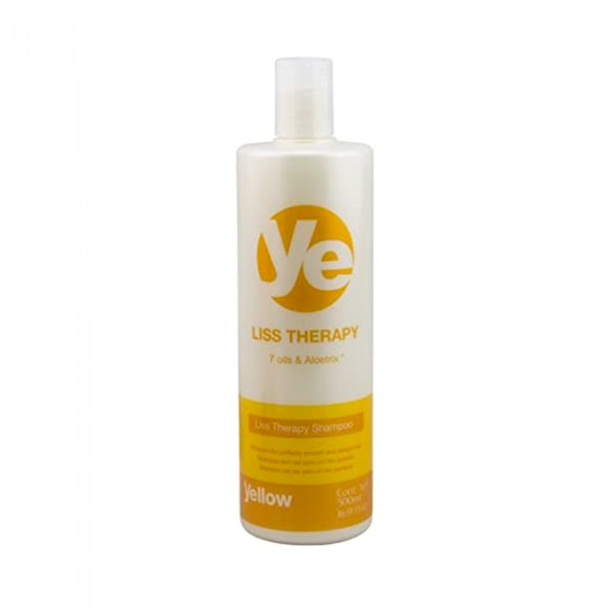
Yello
Yellow Balm With Bambu Extract And Seven Other Soft And Singled Hair Care Oils 500ml
56.35 SAR. Q
- Used for the care of soft or singled hair with protein or keratin.
- Alpha Parv Yellow Balm contains 7 natural oils and bamboo extract gently moisturizes hair for smooth or singled hair using hair straightener products, protein-treated hair or hair keratin.
- A yellow balm containing seven types of carefully selected oils as well as a bamboo extract that nourishes hair, increases its glitter and keeps its smooth shape.

Slide 3
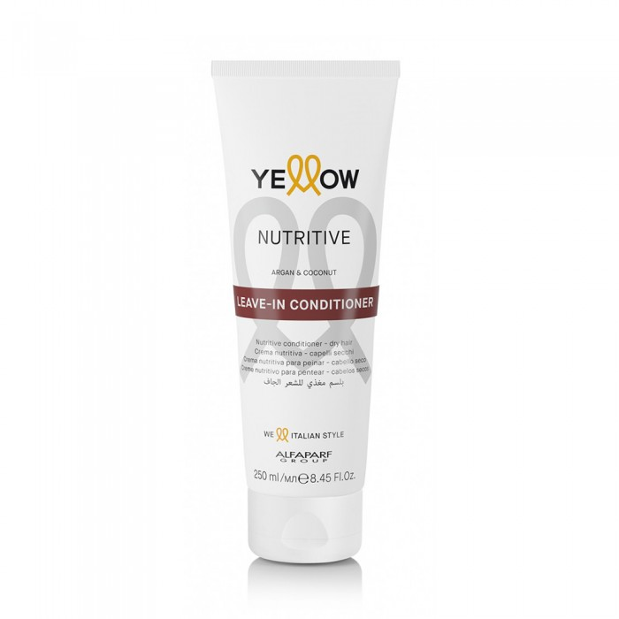
Yello
Yellow Nutrition Conditioner to Untangle Hair With Argan Oil 250ml
56.35 SAR. Q
- Gives the perfect help to untangle dry hair, the hair becomes moisture-rich for a long time.
- Combination of argan oil and coconut oil for smooth hair and easy to lay off

Slide 4
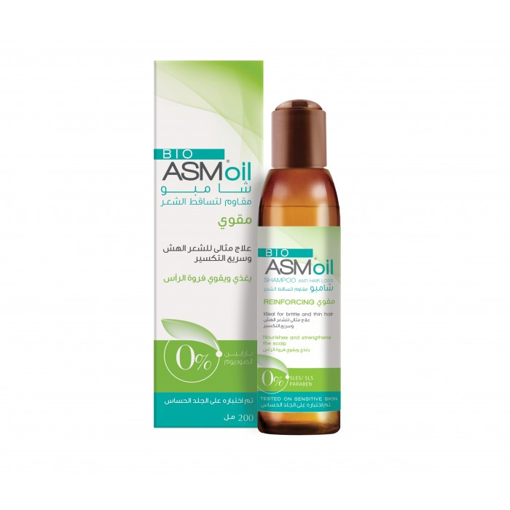
Bio ASM
Bio ASM Reinforced Shampoo & Hair Loss Resistant 200ml
112.70 SAR Q
The Kingdom's first oil shampoo to strengthen and prevent shelling and hair loss with a natural formula such as jojoba oil, grape seed oil, panthenol, ceramide and free from sulphate, paraben and sodium to maintain strong hair without shedding.

Slide 5
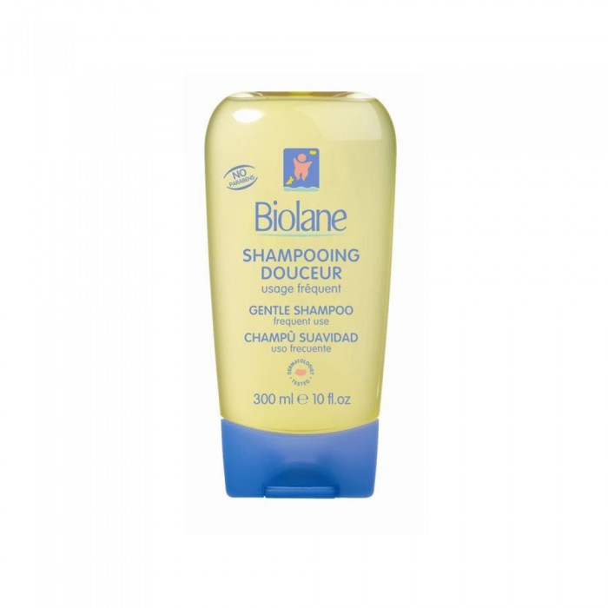
Biolan shampoo nourishing and gentle on the scalp 300 ml
62.10 SAR. Q
Biolan Gentle shampoo is designed to clean and care for the baby's hair. Rich in honey and anti-entanglement ingredients that make combing activities easier, its light formula is also suitable for frequent washing shampoo for the whole family.

